Slide 1
UML
Class Diagram
Component diagram
Deployment diagram: Static view of runtime simulation
Flowchart
Package Diagram
Object Diagram: Instance of Class Diagram
Start/End
Composite structure diagram:
Shows internal structure of class
Activity Diagram
Process: do this to this input etc.
Timing Diagram
Interation overview diagram
Manual
input
Sequence Diagram:
Shows interactions of objects at a timed sequence
Profile Diagram
decision
Use Case Diagram
State machine diagram

Slide 2
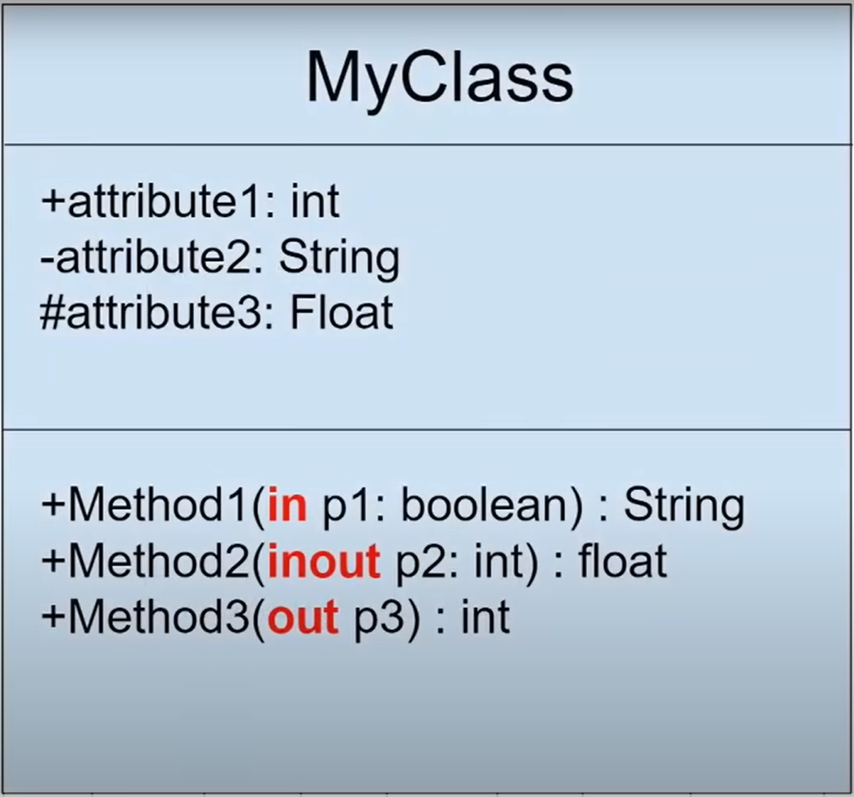
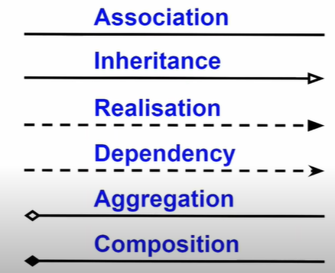

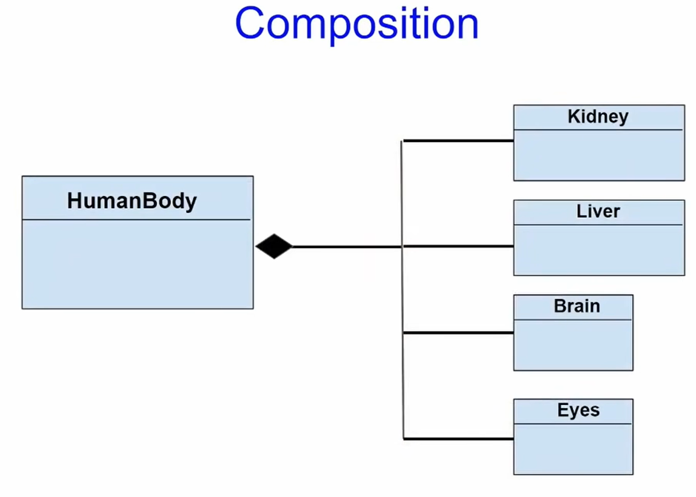
Class Diagram
+Public
#Protected
~Package local
-Private
Implementation to interfaces
in: just input
inout: modification
out: repository variable

Slide 3
UserSignUp
SignUp opened
Will photo be put?
UserValidator
UserHistoryChecker
users.txt
Get user signup input

Slide 4
Change User Info

Slide 5
Play
Team info
Season
Finals
drafting
Weeks
formPlayerList()
1st match
2nd match
…
20 team

Slide 6


















